Slide 1

Freelancing Application Using MERN
The primary aim of this project is to develop a web-based freelancing application using the MERN stack, a powerful combination of MongoDB, Express.js, React.js, Node.js. The goal is to create an efficient, user-friendly platform that streamlines the freelancing process, fosters collaboration, and enhances productivity for both freelancers and clients. The project will be undertaken by a team consisting of HEMAPRIYA.C, JOTHILAKSHMI.R, HARINI RAMESH, HARINI.G, each bringing their unique expertise to the table.

Slide 2
INTRODUCTION
Objectives
Team Members
This project aims to build Developer’s Hub, a freelancing platform using the MERN stack. It connects freelancers and businesses, offering features like job search, messaging, secure login, and real-time performance. The platform addresses freelancing challenges and integrates payment and review systems for trust and scalability.
The project team comprises the following individuals with diverse expertise:
HEMAPRIYA.C : Full Stack Developer
JOTHILAKSHMI.R : Frontend Developer
HARINI RAMESH : Backend Developer
HARINI.G : DevOps Engineer.

Slide 3
MERN Stack Architecture
MongoDB
Express.js
A NoSQL document database storing data in flexible JSON-like documents. This allows for schema-less design and easier scaling. It's ideal for handling large amounts of unstructured or semi-structured data, making it a good choice for user profiles and project details.
A back-end web application framework for Node.js. It simplifies the process of building APIs and handling HTTP requests and responses, providing a robust foundation for server-side logic.
React.js
Node.js
A front-end JavaScript library for building user interfaces. Its component-based architecture promotes reusability and maintainability, leading to a dynamic and responsive user experience.
A JavaScript runtime environment allowing server-side execution of JavaScript code. Its asynchronous, event-driven nature makes it efficient for handling real-time applications and managing multiple concurrent users.

Slide 4

MongoDB Deep Dive
1
Document Database
Data is stored in BSON (Binary JSON), offering flexibility and efficiency. This schema-less approach allows for easy adaptation to evolving data structures.
2
Scalability and Performance
MongoDB excels at handling large datasets and high traffic loads through sharding and replication. This ensures the application remains responsive even under heavy usage.
3
Querying and Indexing
Powerful querying capabilities and indexing options allow for efficient data retrieval. This is crucial for features like searching for freelancers with specific skills or finding relevant projects.

Slide 5
React.js in Developer's Hub
Component-Based Architecture
JSX and Virtual DOM
Rich Ecosystem
JSX simplifies HTML integration within JavaScript, and the virtual DOM optimizes updates for improved performance and a smoother user experience.
A vast library of third-party components and tools enhances development speed and functionality. This allows developers to leverage existing solutions for common tasks.
Reusable components create a modular and maintainable codebase. This streamlines development and allows for consistent UI elements across the application.

Slide 6

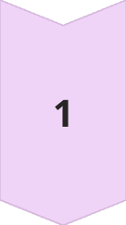
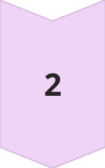
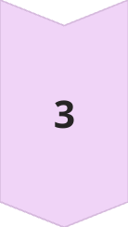
Node.js and Express.js Backend
API Endpoints
Express.js facilitates the creation of RESTful APIs for communication between the front-end and back-end. This allows for seamless data exchange and interaction with the database.
Middleware
Middleware functions handle tasks like authentication, authorization, and logging. This adds layers of security and functionality to the application.
Routing
Express.js defines routes for different URL endpoints, mapping them to specific controller functions. This ensures efficient handling of user requests and navigation within the application.

Slide 7
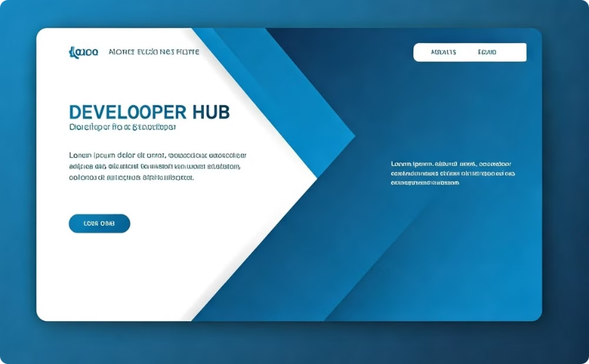

Developer's Hub Implementation: Client-Side
User Interface
Project Discovery
React.js components create a dynamic and responsive user experience, with intuitive navigation and clear presentation of information.
Users can easily browse and filter projects based on their skills and interests. A robust search function allows for quick and efficient project discovery.

Slide 8

Developer's Hub Implementation: Server-Side
1
Database Interaction
Mongoose handles database operations, ensuring secure and efficient data storage and retrieval. This allows for seamless synchronization between the application and the database.
2
API Routes
Express.js defines API endpoints for handling user requests and data exchange between the client and server. This creates a well-defined interface for communication.
3
Authentication and Security
JSON Web Tokens (JWT) provide secure authentication and authorization, protecting user data and ensuring the integrity of the platform.

Slide 9

Challenges and Solutions
Challenge
Solution
React.js complexity
Component-based architecture and clear coding conventions
Node.js scalability
Modular code and efficient resource management
MongoDB mobile limitations
Optimized data synchronization strategies

Slide 10




Conclusion
Connecting Freelancers and Businesses
Developer's Hub provides a dedicated platform for freelancers and businesses to connect, fostering collaboration and opportunity.
Empowering New Freelancers
The platform aims to simplify entry into the freelancing world, providing resources and opportunities for career growth.
Leveraging MERN Stack
The MERN stack's flexibility and scalability enable a robust and dynamic application that can adapt to the evolving needs of the freelancing community.

